Slide 1
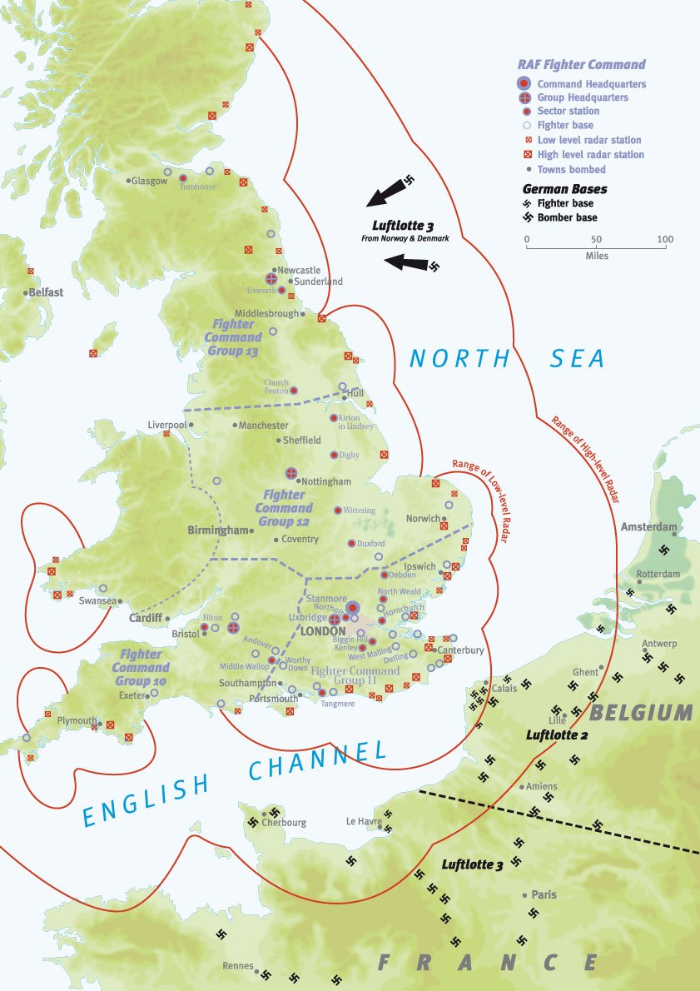
Radar History

Slide 2


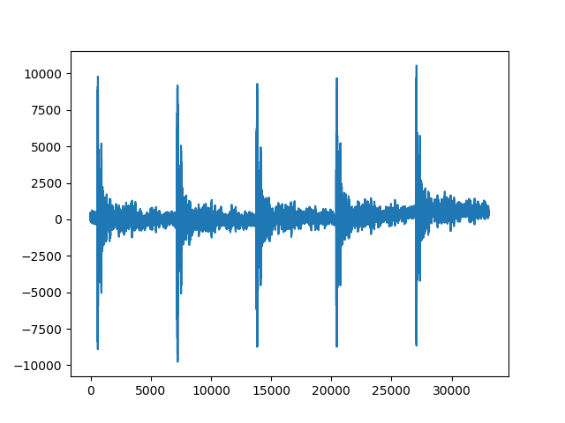
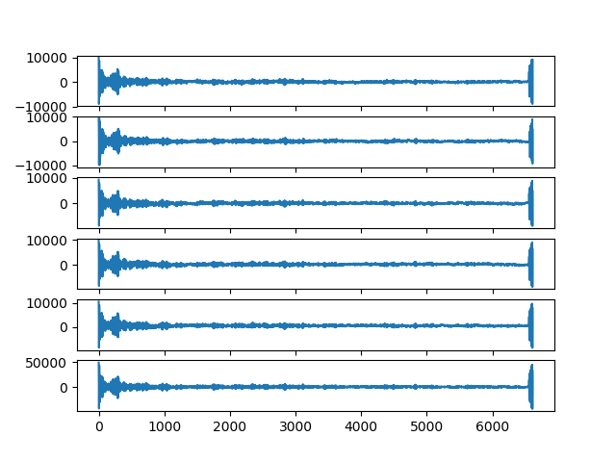
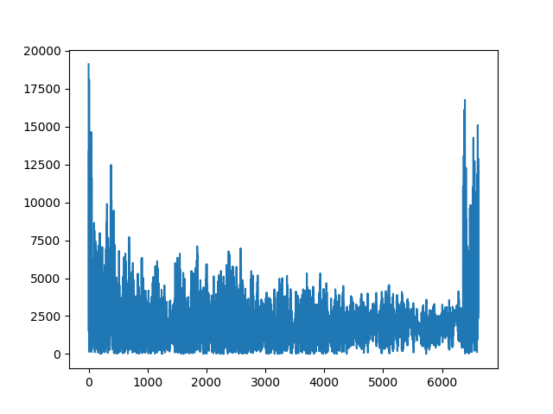
Location: UP lobby
Distance: 7m
Pulse train:
Pulse Train
Gating
Only positive value

Slide 3
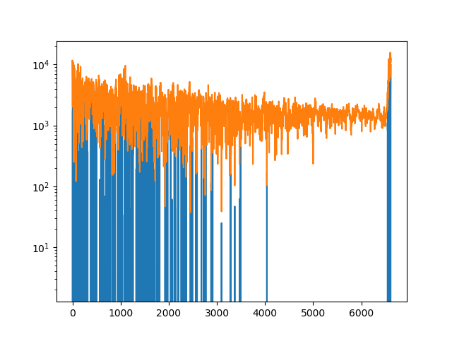
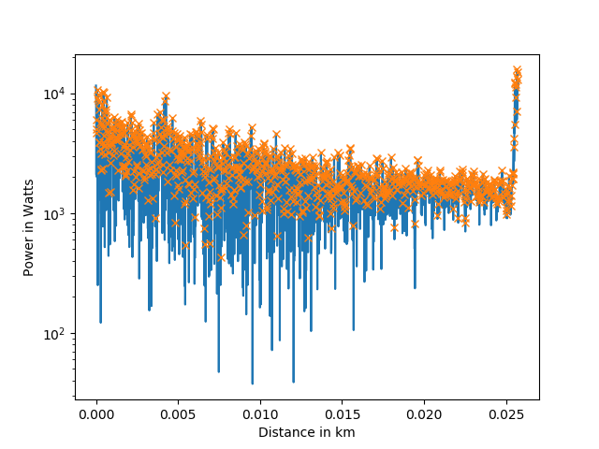
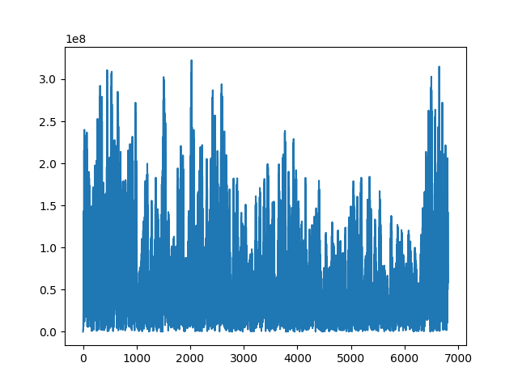
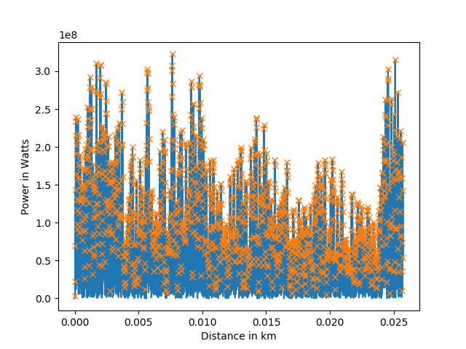
Envelope detection
Peaks
Cross-correlation
Peaks to determine Distance

Slide 4

Summary:
$$Runambiguous Distance=\frac{Vp ∗t}{2}$$

